Slide 1
Automated TestFit
Introduction

Slide 2
Key Value proposition
PRD document
Save time on repeated test fit tasks,
Provide customers with a one-click magic automated test fit,
Use data to drive design and test fit.

Slide 3
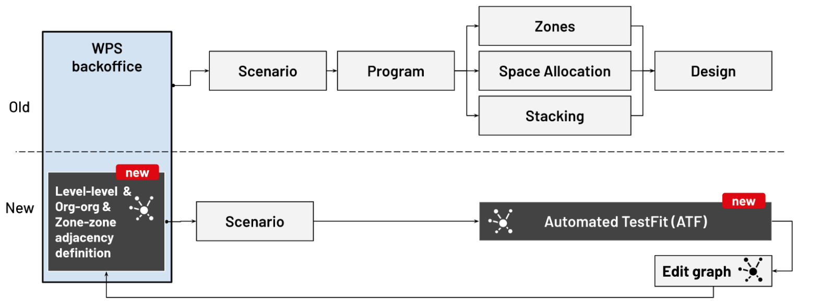
Vision : one-click magic.
Current state
Inputs:
Output
Program,
Core, and
Shell.
3 optimal floor plans

Slide 4
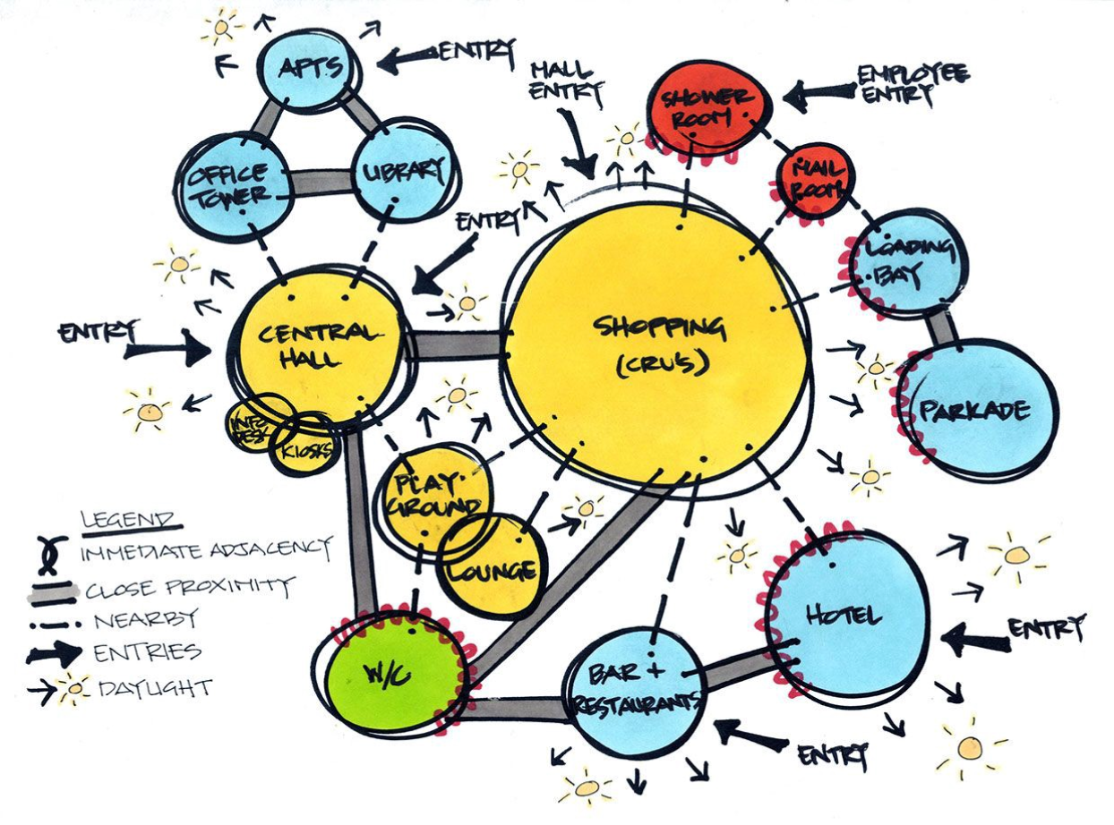
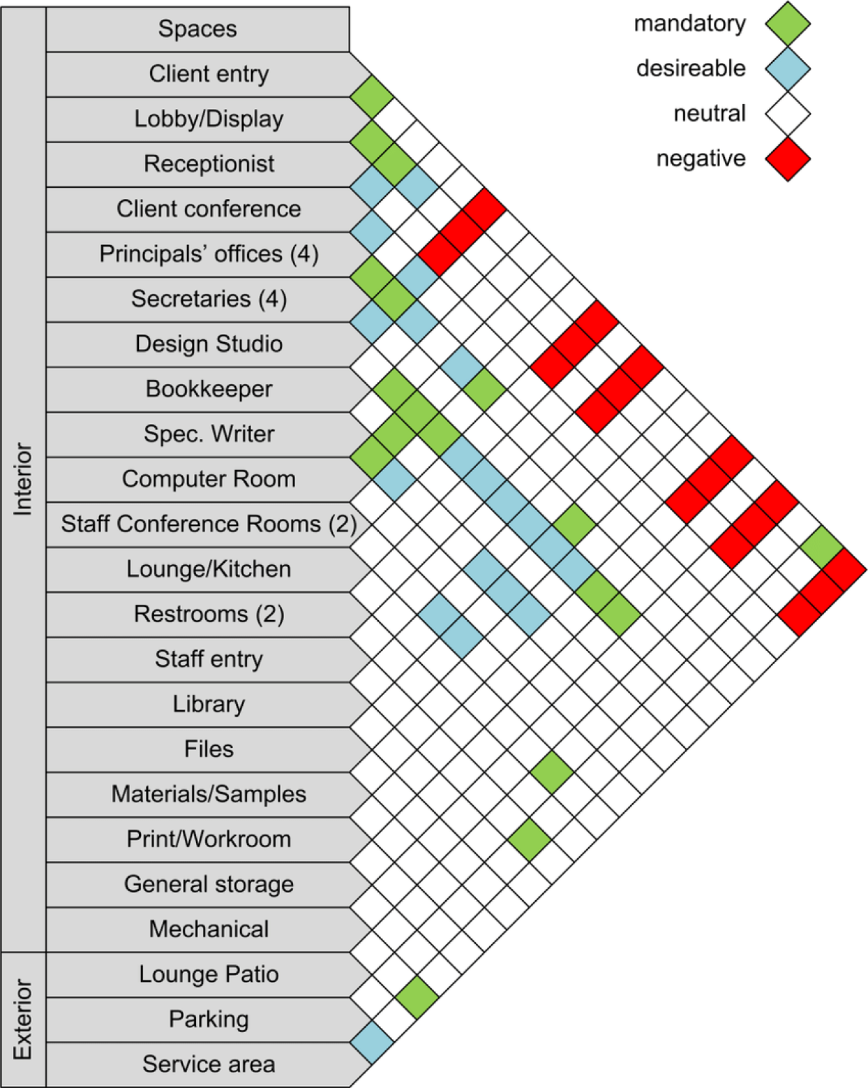
How the design process is done manually ?
Architects and space planners use Bubble diagrams, and Adjecency matrices to define the best allocation of spaces in a floor plan.
Bubble diagram (domain knowledge term):
Graph network.
Adjacency matrix (domain knowledge term):
Adjacency matrix
Adjacency list

Slide 5
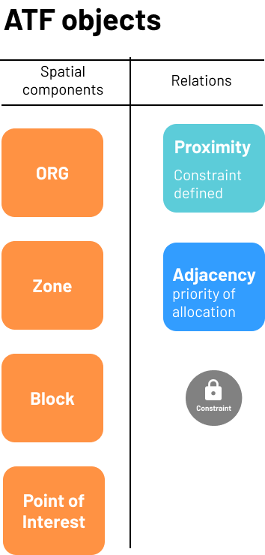
Adjacency, Proximity, Points of interest, Constraints
Spatial components
Org: Organization unit - consists of multiple zones.
Zone: Group of blocks that serve a specific purpose.
Block: Saltmine block.
Point of Interest (POI):
Any spatial object that is defined by (x,y) coordinates and has constraints. For example: fire escape door (maximum 30 m from any point).
Relations
Adjacency: priority (1 = low , 3 = high).
Proximity: distance constraint (20-30 m).

Slide 6
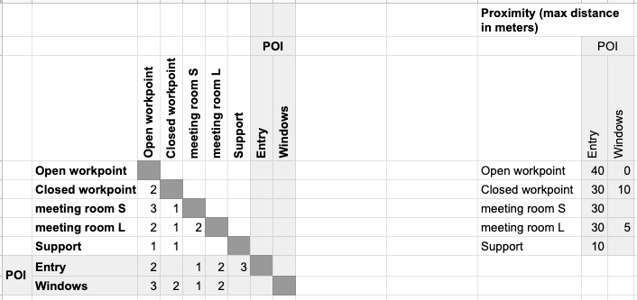
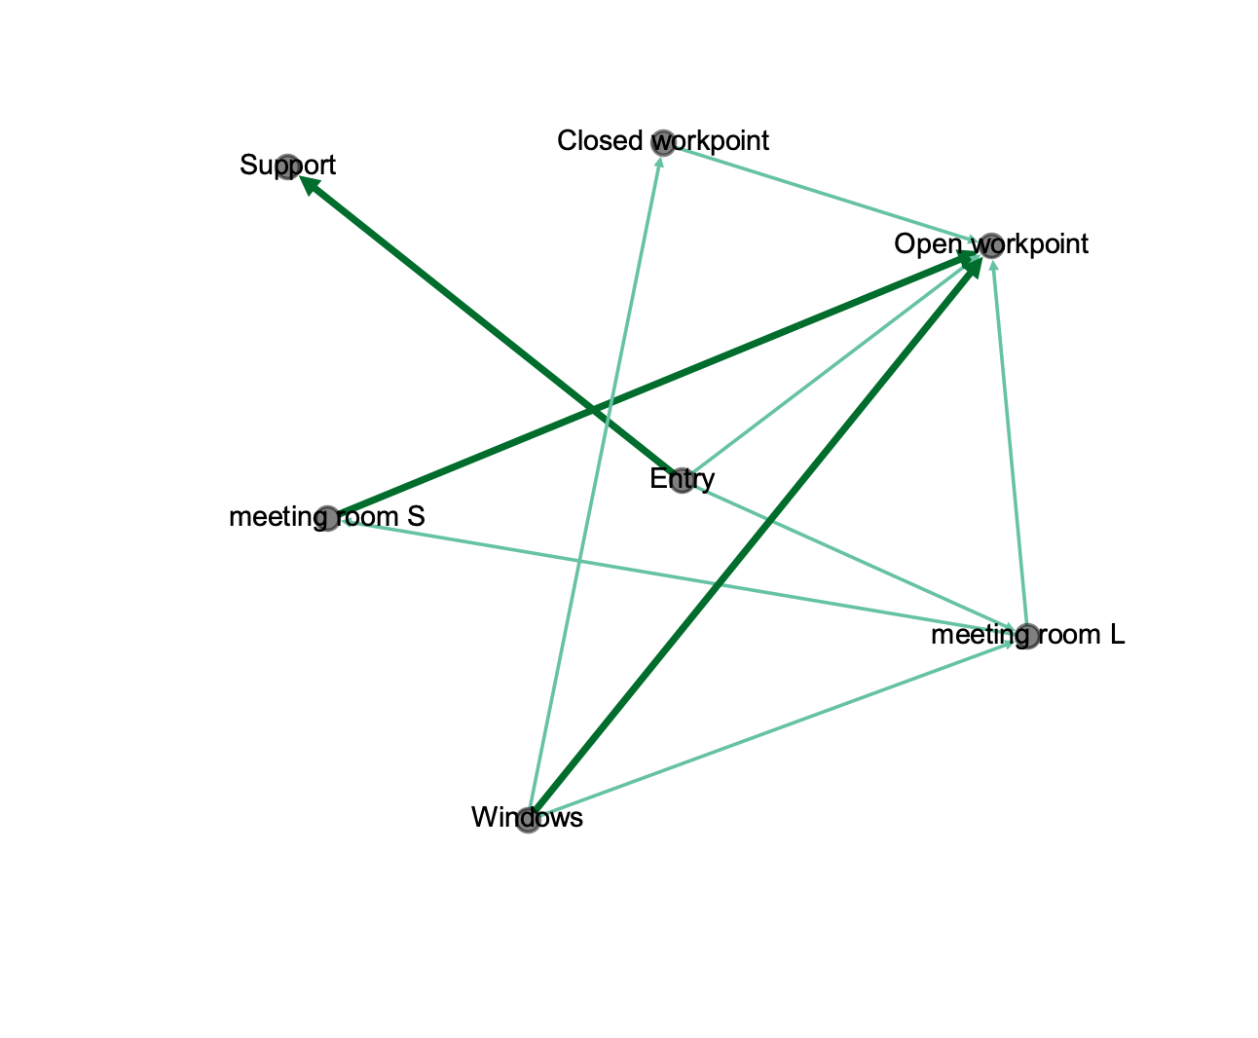
How adjacency and proximity are defined?

Slide 7
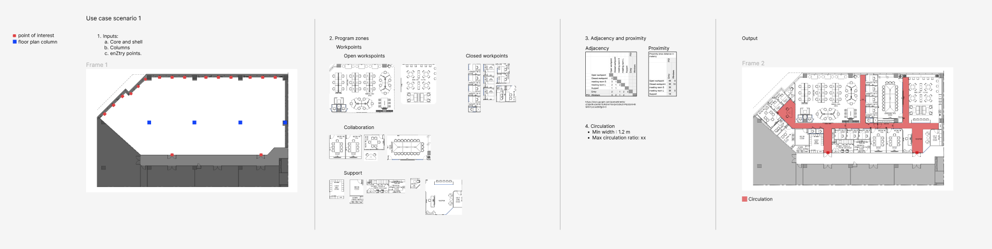
How adjacency and proximity are defined?
Example use case

Slide 8
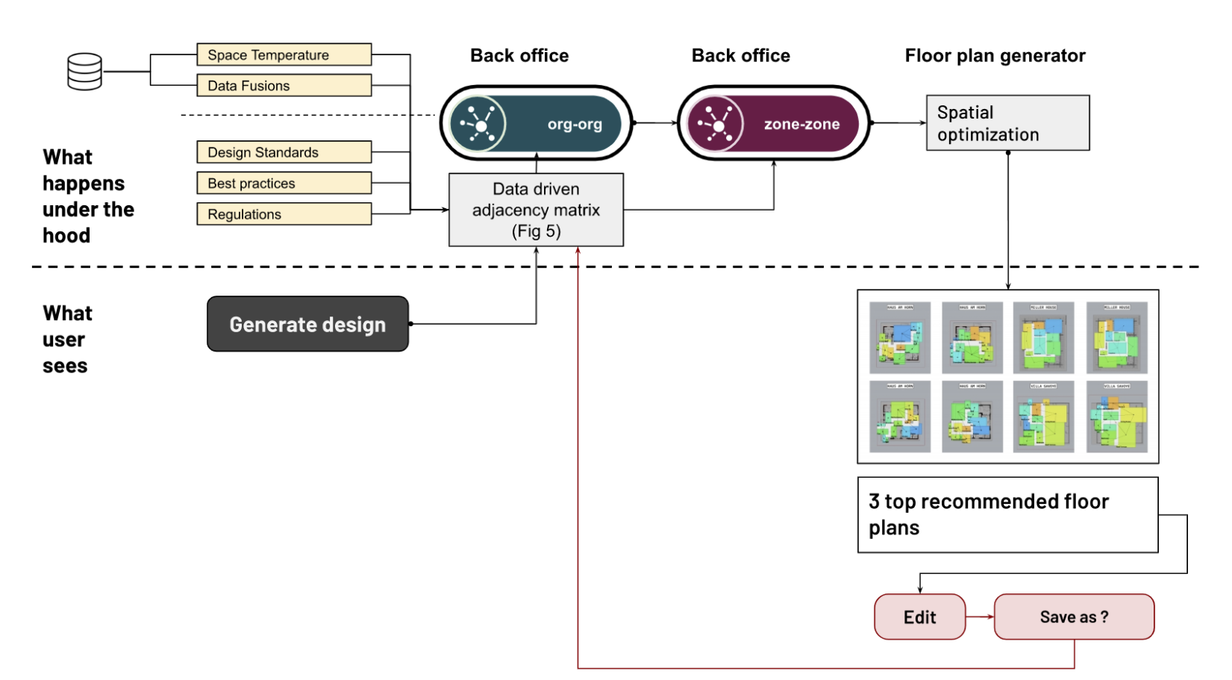
Data driven approach
Example on the calculation logic

Slide 9
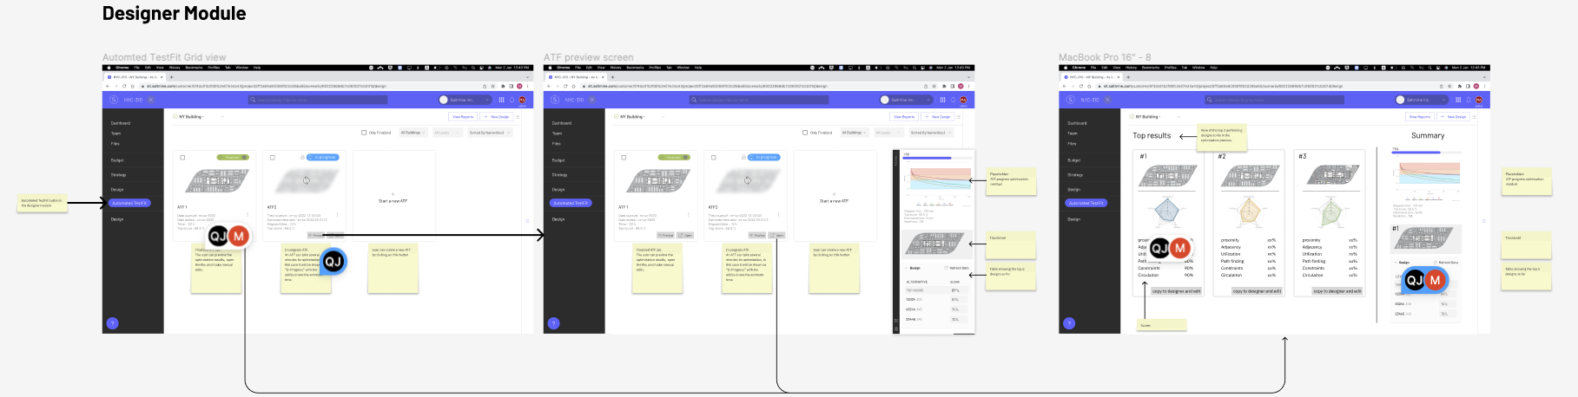
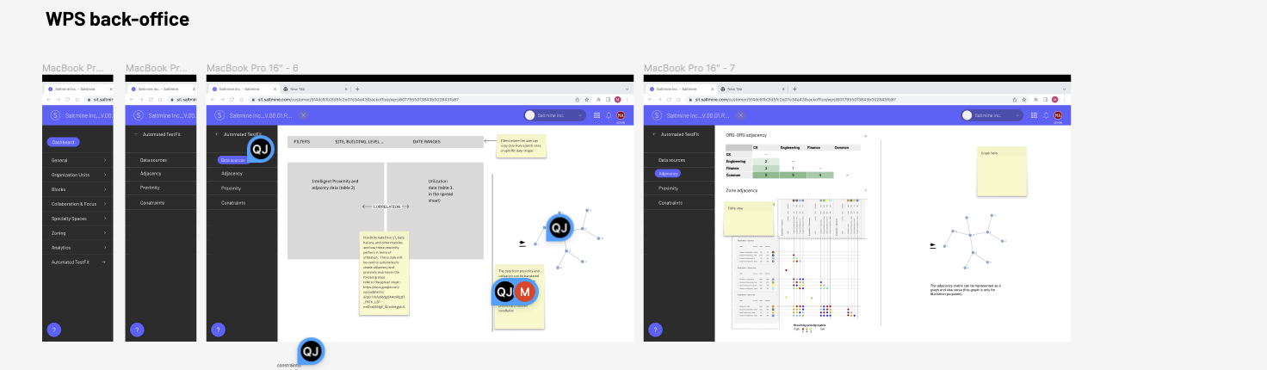
Suggested flow

Slide 10
Challenges to be addressed
Process | Inputs | Outputs
Auto Circulation | Building physical elements (points of interest) . for example entrance, fire exit, windows, water points, columns and walls. Core and shell. Program. | Auto Circulation (scoring and ranking top 3 options).
Auto Zone Fitting | Building physical elements Programme Output Proximity Adjacency | Space allocation (scoring and ranking top 3 options). Additional Intelligence (auto Learning)
Auto Block Fitting | Section-wise Block List Block intelligence data. Proximity Adjacency | Secondary Circulation Block allocation (scoring and ranking top 3 options ). Additional Intelligence (auto Learning).

